Slide 1
AR-BASED MUSEUM APP
By- KRITIKA GUPTA & SPARSH AHUJA
Guided by- PROF. ANUPAM AGARWAL

Slide 2
AUGMENTED REALITY
AR IS THE ADDITION (AUGMENTATION) OF VIRTUAL DIGITAL OBJECTS TO THE REAL ENVIRONMENT AROUND US. THESE AUGMENTED VIRTUAL OBJECTS CAN BE PLANE 2D AND 3D IN THE FORM OF TEXT, AUDIO OR IMAGES. MAINLY DIVIDED INTO TWO TYPES:-
1. MARKER BASED AR
Uses embedded visual markers in the system to superimpose virtual elements.
The markers to be recognized are provided beforehand.
Virtual object remain stick to the physical marker.
2. MARKER-LESS AR
AR application that does not require any pre-knowledge of a user’s environment to overlay 3D content into a scene.
Allows to move the virtual object.

Slide 3
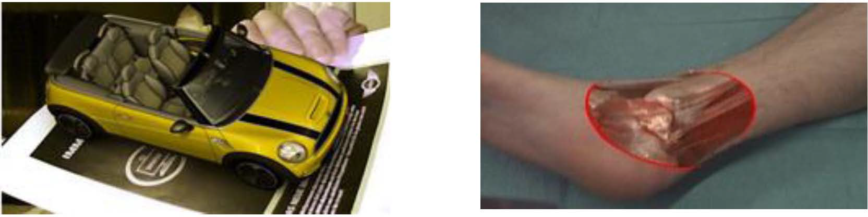
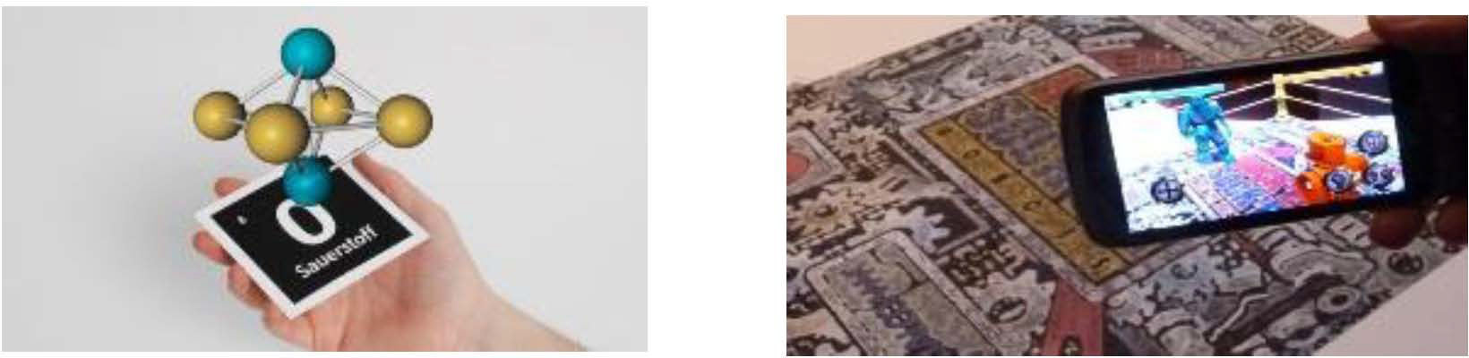
Advertising and marketing
Uses of AR [2]
Medical
Education
Entertainment

Slide 4
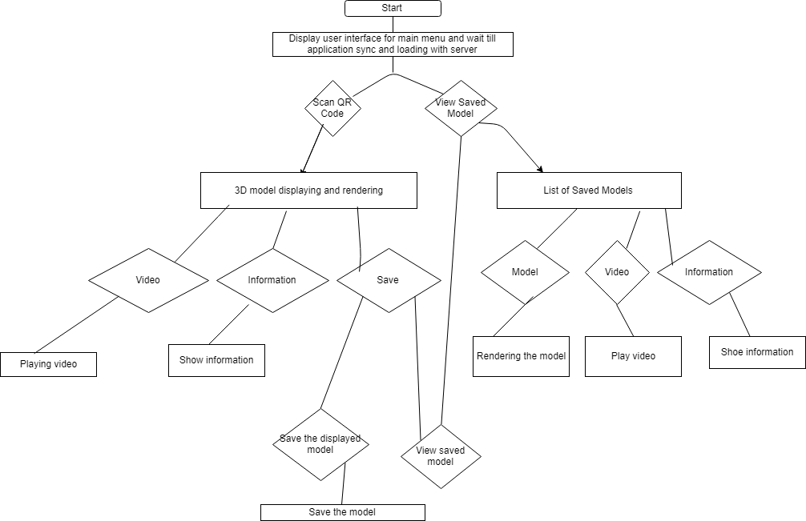
ABOUT THE APPLICATION

Slide 5
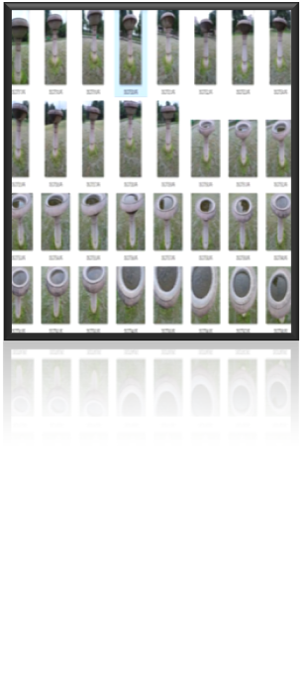
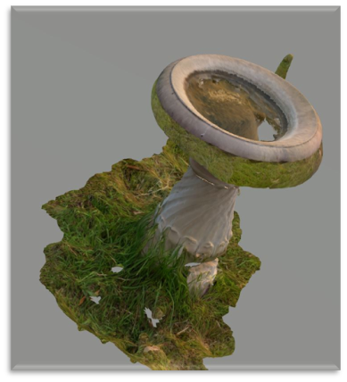
3D MODEL CREATION
SCREENSHOT OF MODEL CREATION USING REGARD3D

Slide 6
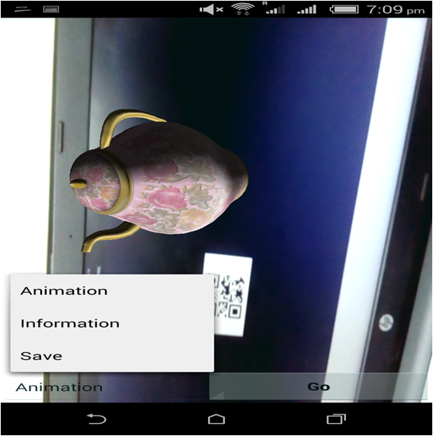
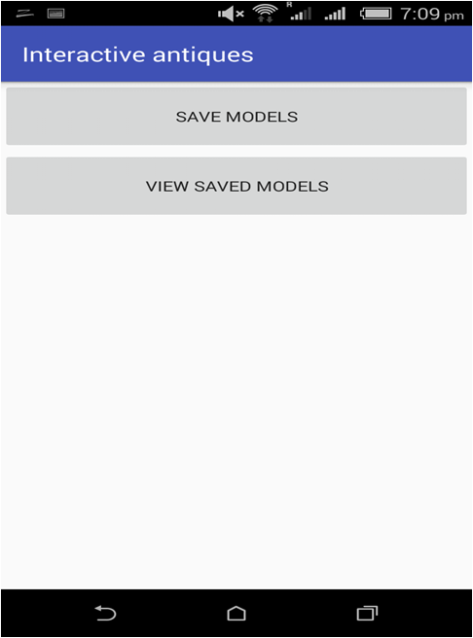
SAVE OFFLINE
SAVED MODELS
SCREENSHOT OF EXISTING MOBILE APPLICATION

Slide 7
HARDWARE: SMART PHONES AND COMPUTER SYSTEM (6GB RAM)
SOFTWARE:
REGARD3D AND BLENDER (3D MODEL CREATION AND SIZE REDUCTION)
MIN3D LIBRARY (LOADING 3D MODELS)
ANDROID STUDIO 3.2 (CREATING APPLICATION)
Tools Used

Slide 8
Change the texture of the existing 3D Model in the application.
To reduce the size of the 3D Model.
Add the option to view the information about the internal memory used by a model.
Show the percentage of internal memory available for usage.
Add delete option for the saved models in application to free up the internal memory.
Pop up on pressing delete for user confirmation.
To improve GUI.
OBJECTIVE

Slide 9
An avatar guide for storytelling and explanation for an object when user is near the object.
Interactive test game of sorting artifacts.
Interactive coloring game.
Quiz game to test understanding
POSSIBLE EXTENSIONS OF CURRENT EXISTING WORK

Slide 10
ACTIVITY CHART
S.No. | Dates | Workflow
1. | 15 May to 21 May 2019 | Reading the research papers related to the problem statement and decide the proposed work according to the existing work
2. | 22 May to 28 May 2019 | Setting up environment and learning to use the tools involved in the pre developed app.
3. | 29 May to 4 June 2019 | Import the code of the pre developed app in the system and run it, and look up for the next step to integrate the game
4. | 5 June to 14 June 2019 | Learn to change the texture of an existing 3D model and reduce the size of model formed by photometry.
5. | 15 June to 24 June 2019 | Add the delete option in the existing application to free up the phone’s internal memory.

Slide 11
6. | 16 June to 30 June 2019 | Improve App’s GUI to make it more explanatory.
7. | 1 July to 7 July 2019 | Prepare final report for the work completed during the summer internship.

Slide 12
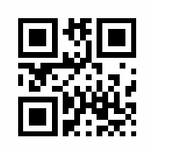
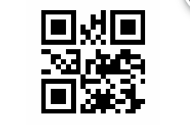
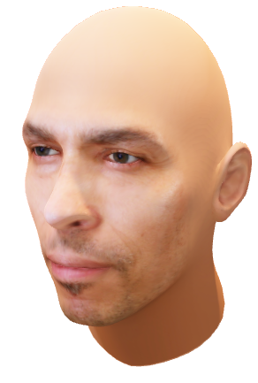
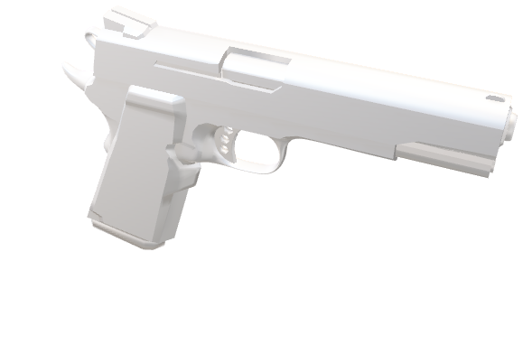
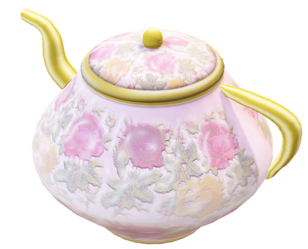
DATA SETS and RESULTS

Slide 13
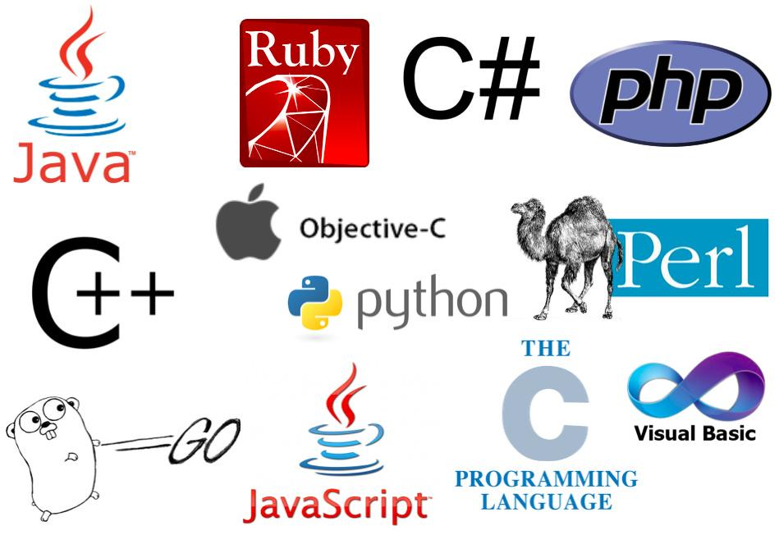


LANGUAGE , TOOLS AND LIBRARIES TO BE USED
Python Java Xml
1. AWS 2.Blender 3.Vuforia 4.Android Studio
1.Open-cv 2.Cycles_ Matlib

Slide 14
WORK COMPLETED SO FAR
Changed texture of existing models.
2. Created a sample basic 3d model with regard 3d .

Slide 15
DETAILS OF TASK UNDER PROGRESS
To select multi models at once:-
Using listview adapters of Android to activate MultiChoice Model Listener.
2. Adding DELETE button to the museum app.
Studying libraries of android to check for user’s left over space and wipe models even from ram after deleting.

Slide 16
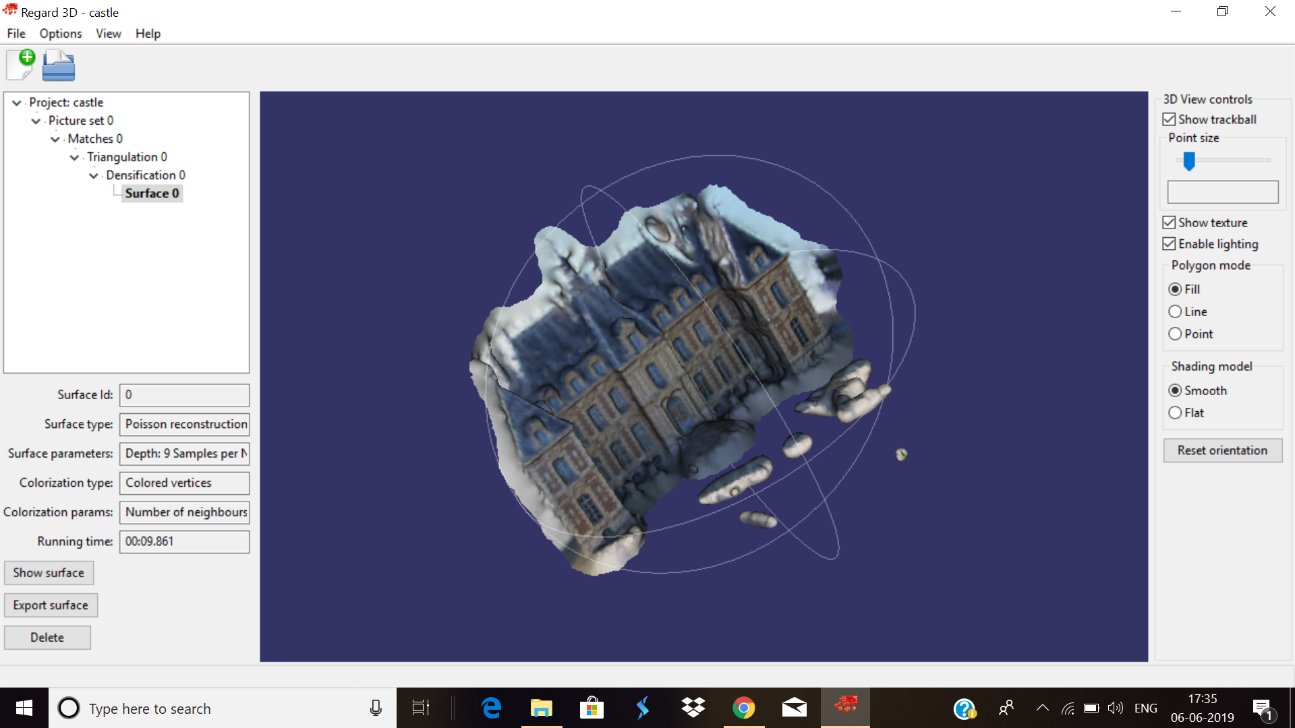
Made a church 3D model in Regard 3D

Slide 17
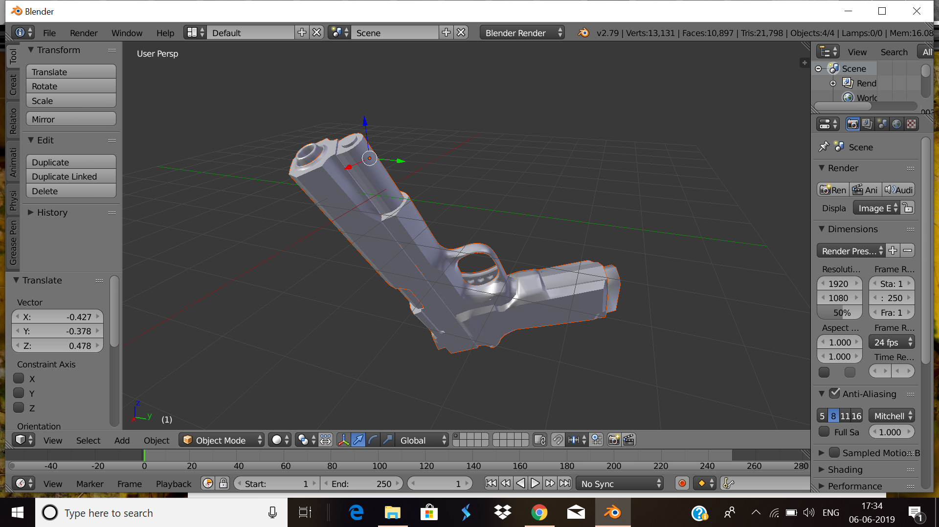
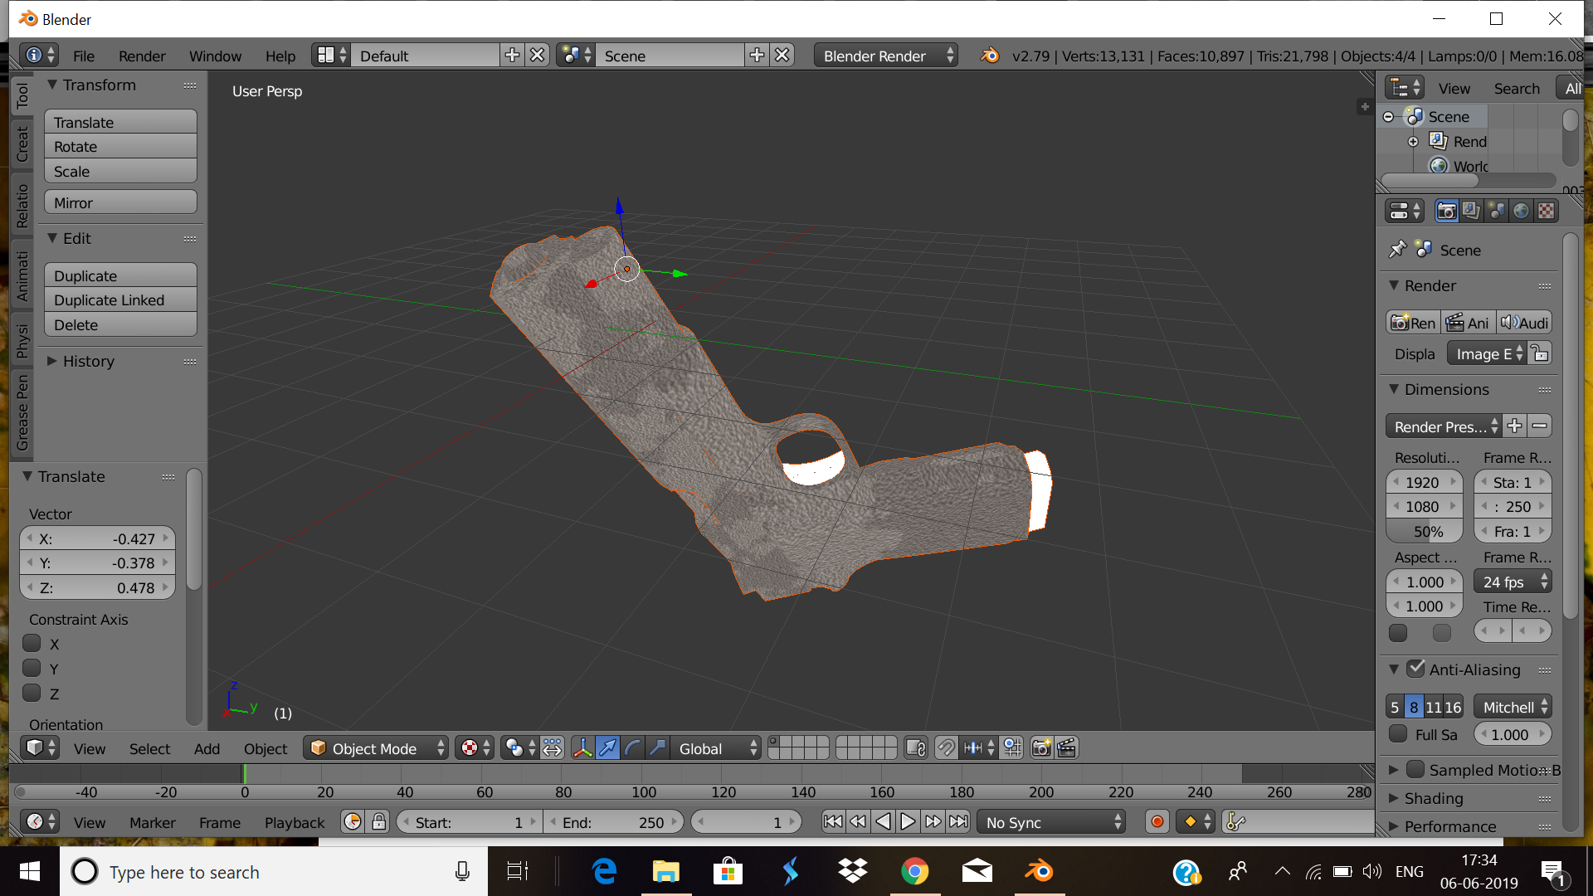
Changed texture of the gun model
OLD NEW

Slide 18
REFERENCES
“F A Purnomo, P I Santosa, R Hartanto, E H Pratisto and A Purbayu ” – Implementation of Augmented Reality Technology in Sangiran Museum with Vuforia - International Conference on Advanced Materials for Better Future 2017
“Loubna Ahmed, Salma Hamdy, Doaa Hegazy and Taha El-Arif”-Interaction Techniques in Mobile Augmented Reality: State-of-the-art - iEEE Seventh international Conference on intelligent Computing and information Systems 2015
“Nehla Ghouaiel, Samir Garbaya, Jean-Marc Cieutat and Jean-Pierre Jessel”- Mobile Augmented Reality in Museums : Towards Enhancing Visitor’s Learning Experience - The International Journal of Virtual Reality, 2016, 17(01): pp21-pp31
“Kathrin Koebel, Prof. Dr. Doris Agotai, Prof. Dr. Stefan Arisona and Dr. Matthias Oberli” - Biennale 4D- A Journey in time - 2017 IEEE\
“Mattia Ryffel, Fabio Zünd, Yağız Aksoy, Alessia Marra, Maurizio Nitti, Tunç Ozan Aydın and Bob Sumner” - AR Museum: A Mobile Augmented Reality Application for interactive painting recoloring - 2017

Slide 19
6. “YAG˘IZ AKSOY, TUNC OZAN AYDIN and ALJOˇ SA SMOLI´C and MARC POLLEFEYS ” - Unmixing-Based Soft Color Segmentation for Image Manipulation -2017
1.https://github.com/kuboshizuma/paper-survey/issues/10
2.https://www.infoq.com/articles/augmented-reality-best-skds/
3.https://www.newgenapps.com/blog/augmented-reality-apps-ar-examples-success
4.https://developer.android.com/reference/android/os/StatFs
5. Reference DataSet for images to formulate church 3d model https://excellmedia.dl.sourceforge.net/project/regard3d/Demo/OpenMVG/SceauxCastle.zip
Other References

